Slide 1
PGB Session
11 April 2024
Ms. Katherine Escobar
NIEMOpen Project Governing Board Chair

Slide 2
Call to order
Called to order the regular virtual meeting of the NIEMOpen Project Governing Board at 2 PM, 11 April 2024.
Notes:
Chair: This meeting is being recorded for the record and a link will be provided in the minutes.

Slide 3
Venue
Microsoft Teams 11 April 2024 PGB Meeting
PGB Meeting
11 April 2024
Virtual Meeting 2-4 PM EST
Virtual: MS TEAMS
Microsoft Teams meeting
Join on your computer, mobile app or room device
Click here to join the meeting
Or call in (audio only)
+1 410-874-6749,,775017873# United States, Odenton
Phone Conference ID: 775 017 873#
Current and post meeting location of 11 Apr PGB Meeting documents:

Slide 4
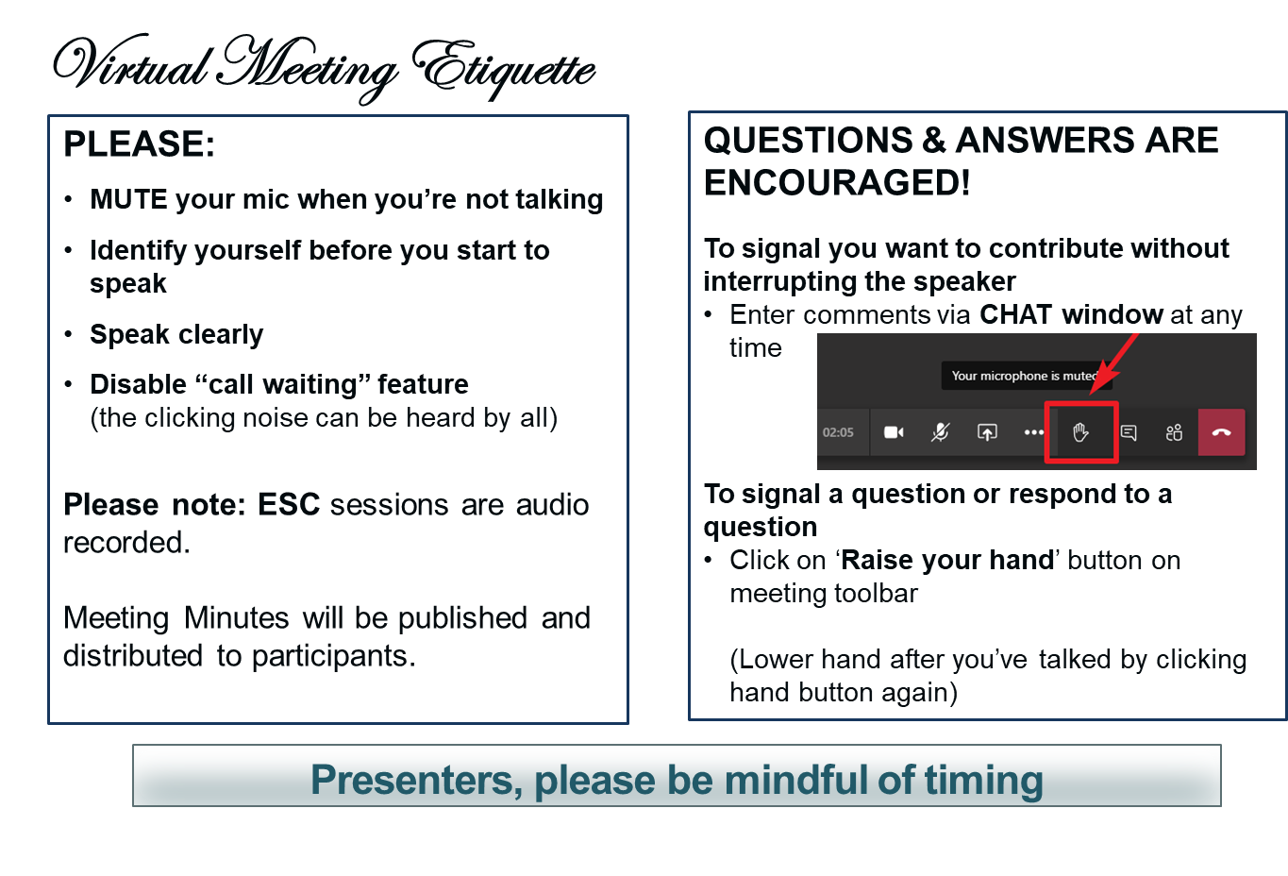
Making the most of our session
Notes:
VOTING: The usual method of voting is viva voce (by voice). To accommodate the virtual setting the chair may ask members to “Raise your hand” to signal aye or no.

Slide 5
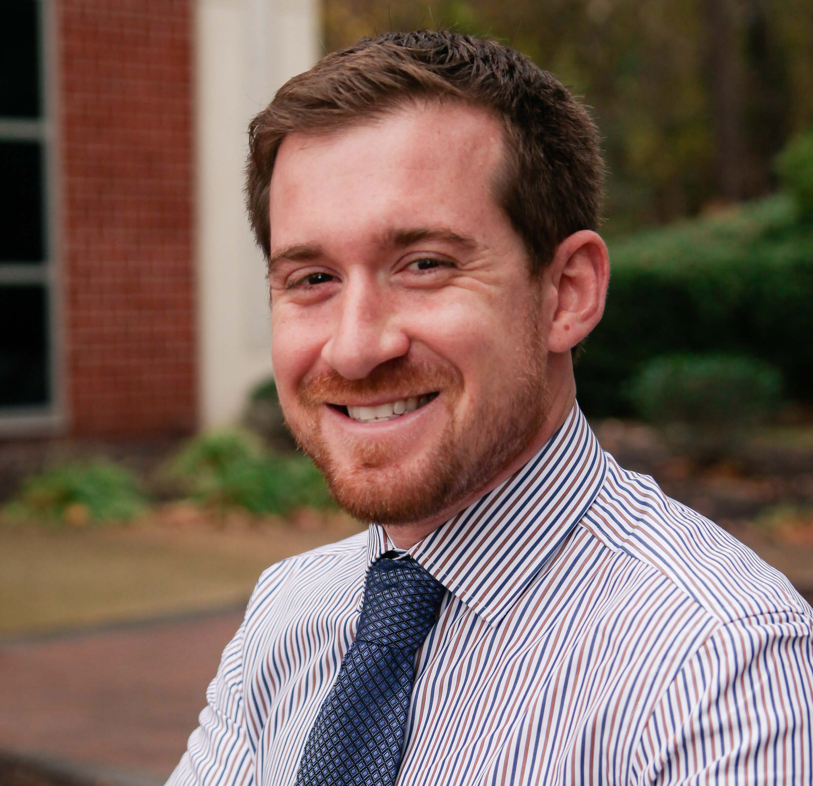
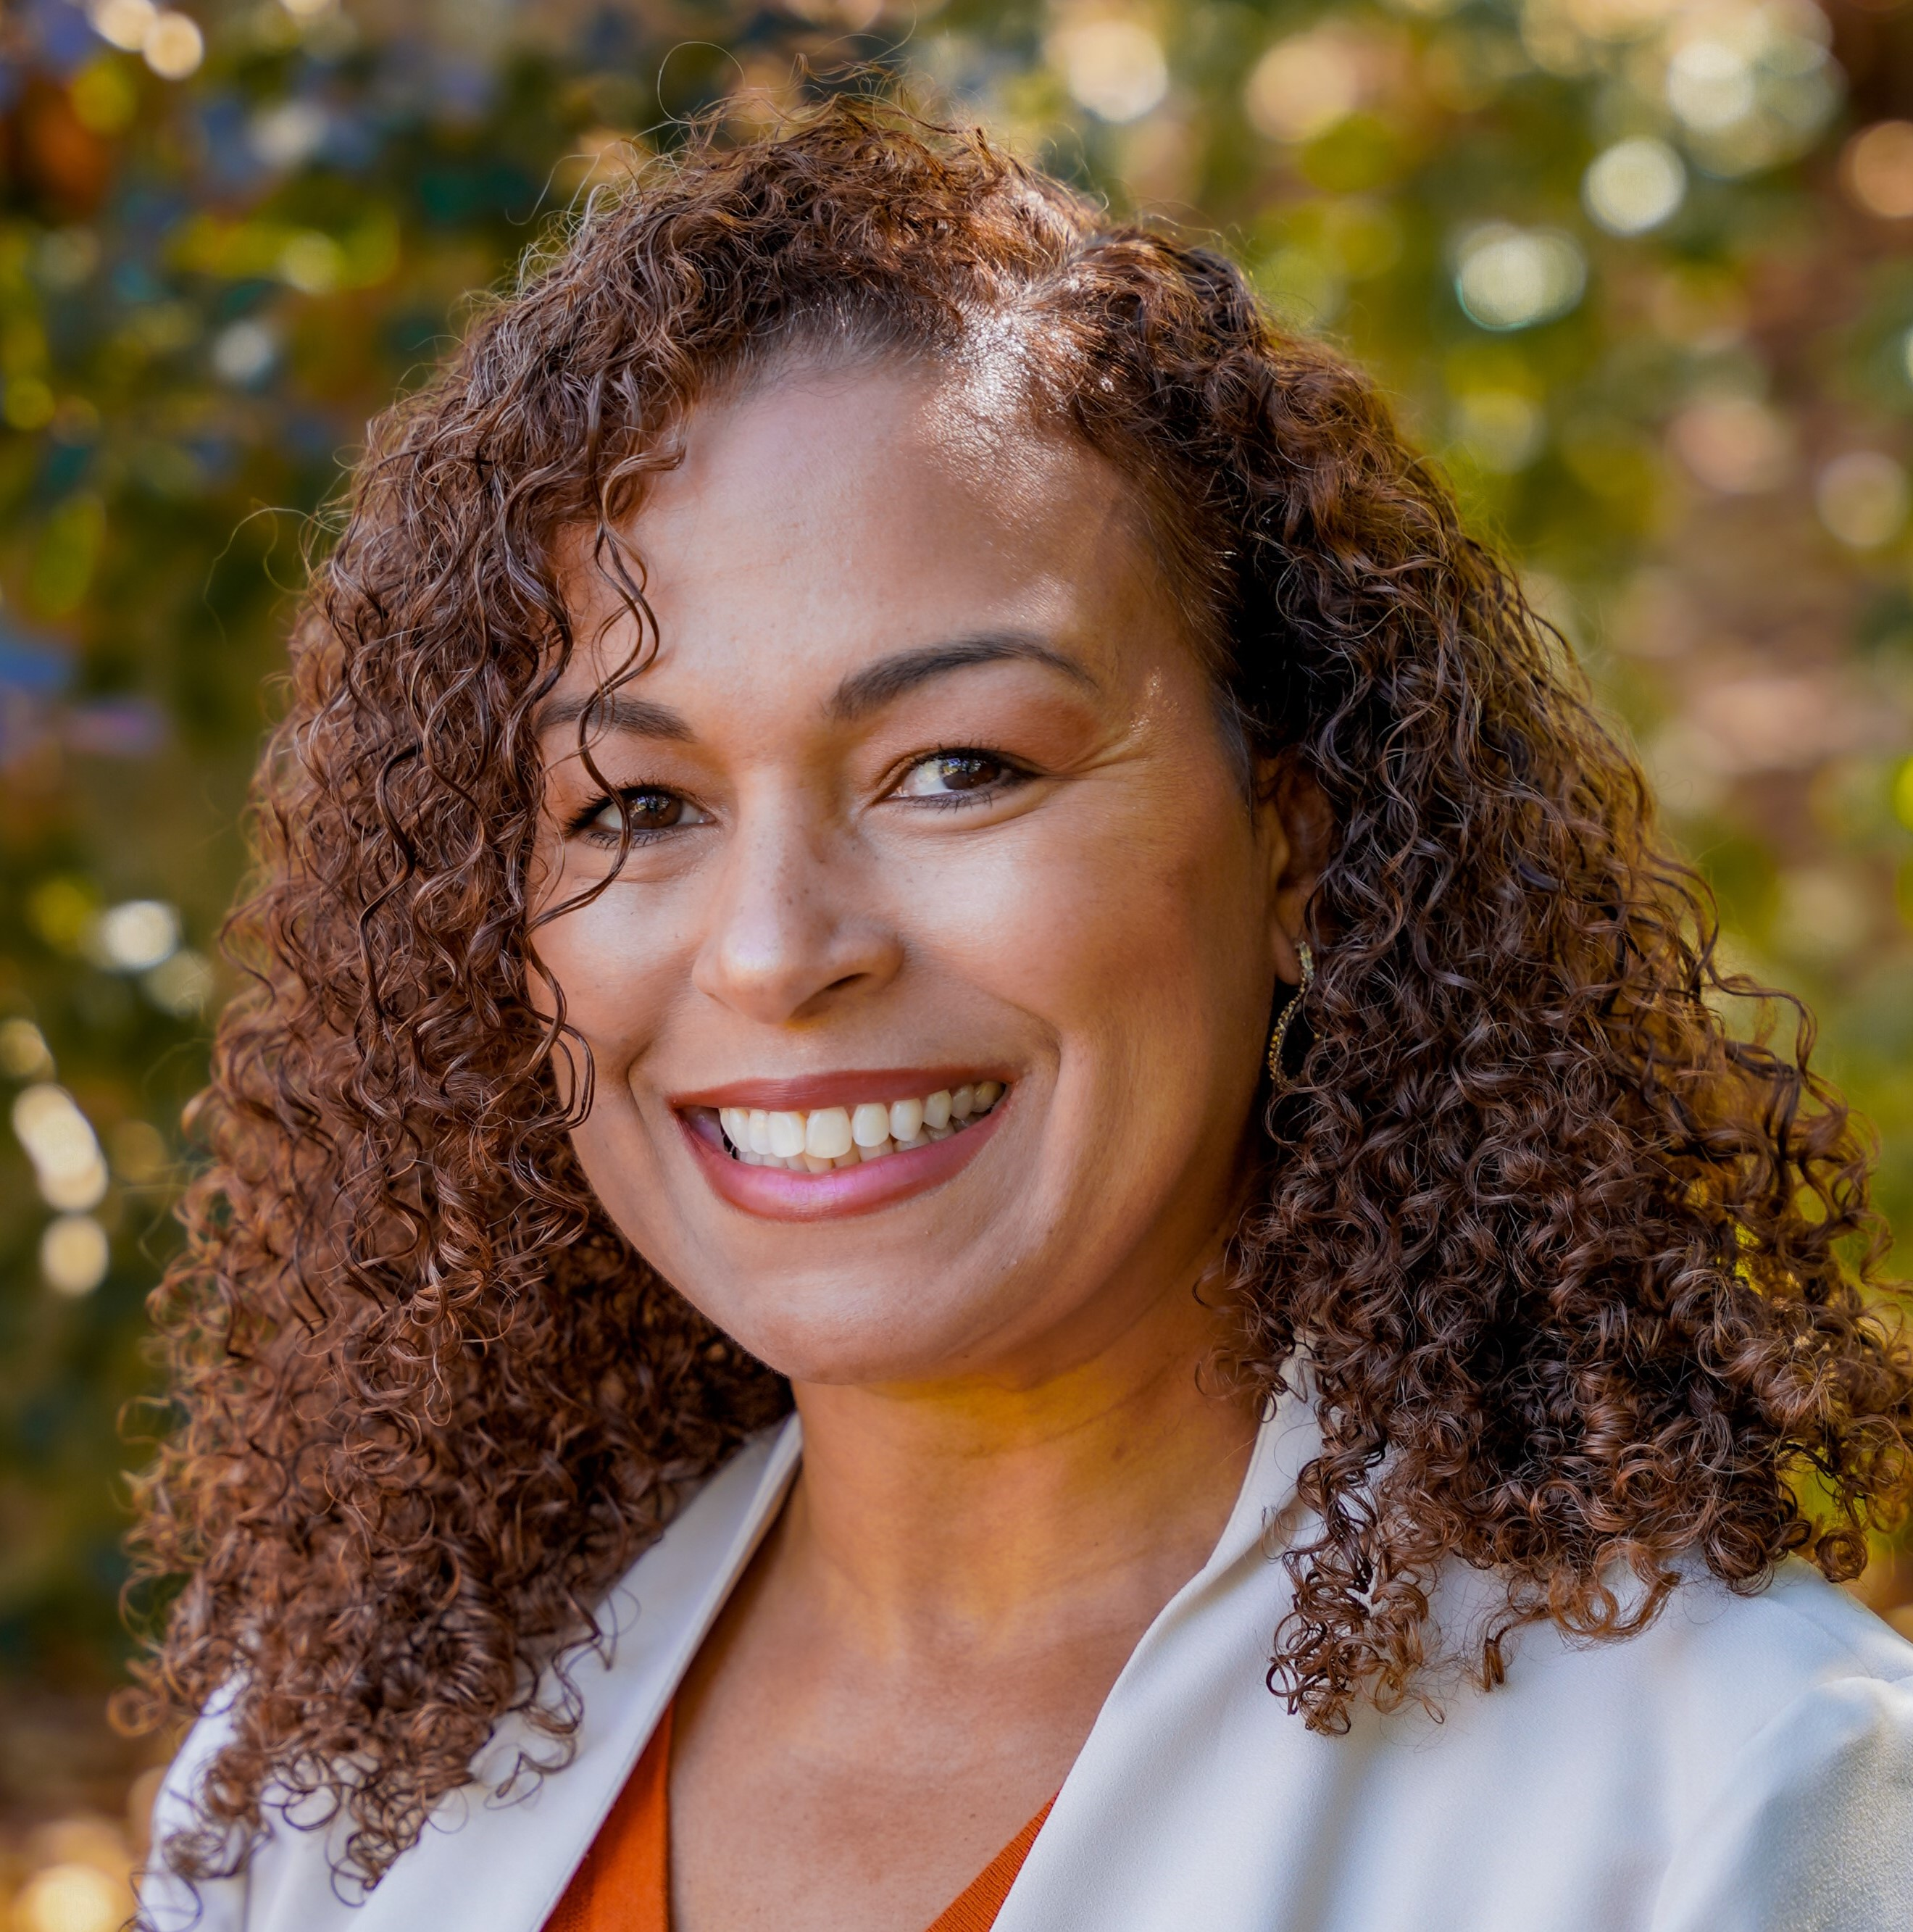
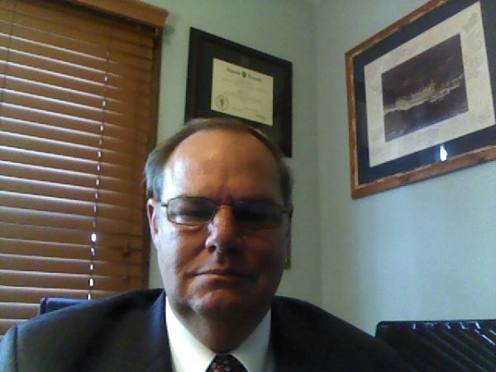
Note taker
The PGB Executive Session is being recorded on MS TEAMS. A link to the recording will be provided and meeting minutes will be posted on the NIEMOpen Git Repo once approved: https://github.com/niemopen/oasis-open-project/tree/main/pgb-meeting-minutes
Meeting support, note takers:
Aubrey Beach
aubrey.l.beach.ctr@mail.mil
Shunda Louis
shunda.r.louis.ctr@mail.mil
Stephen Sullivan
stephen.m.sullivan14.ctr@mail.mil

Slide 6
Roll call
PGB Voting Members:
Department of Defense Joint Staff J6 (DoD JS J6)
Department of Homeland Security Science & Technology (DHS S&T)
Equivant
Georgia Tech Research Institute (GTRI)
Integrated Justice Information Systems Institute (IJIS)
Commonwealth of Virginia, Office of Data Governance and Analytics
Criminal justice Information Systems Division (CJISD), Federal Bureau of Investigation
PGB Expert Voting Members
NBAC TSC
NTAC TSC
NMO TSC
PGB Expert NON-Voting Members
Notes:
Chair: Will the secretary call the role
PGB Voting Members:
Department of Defense Joint Staff J6 (DoD JS J6) – Ms. Katherine Escobar
Department of Homeland Security Science & Technology (DHS S&T) – Ms. Christina Bapst-Stump
Equivant – Mr. Gary Egner
Georgia Tech Research Institute (GTRI) – Mr. John Wandelt
Integrated Justice Information Systems Institute (IJIS) – Ms. Maria Cardiellos
Commonwealth of Virginia, Office of Data Governance and Analytics – Mr. Payton Lamb
Criminal Justice Information Services Division (CJISD), Federal Bureau of investigation, – April Mitchell
PGB Expert Voting Members
NBAC TSC – Mr. Kamran Atri
NTAC TSC – Mr. Jim Cabral (InfoTech)
NMO TSC – Ms. Beth Smalley (Joint Staff J6 DSD)
PGB Expert Non-Voting Members
NBAC TSC – Mr. Thomas Krul (National Defence Canada)
NTAC TSC – Dr. Scott Renner (MITRE)

Slide 7
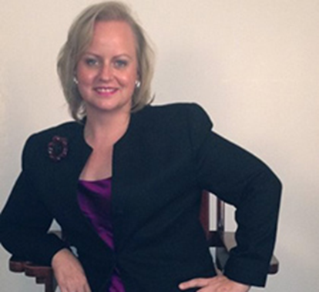
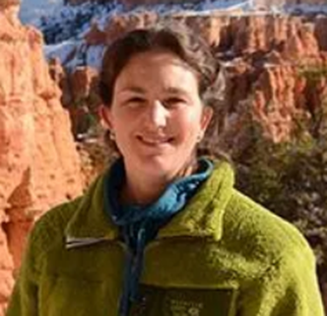
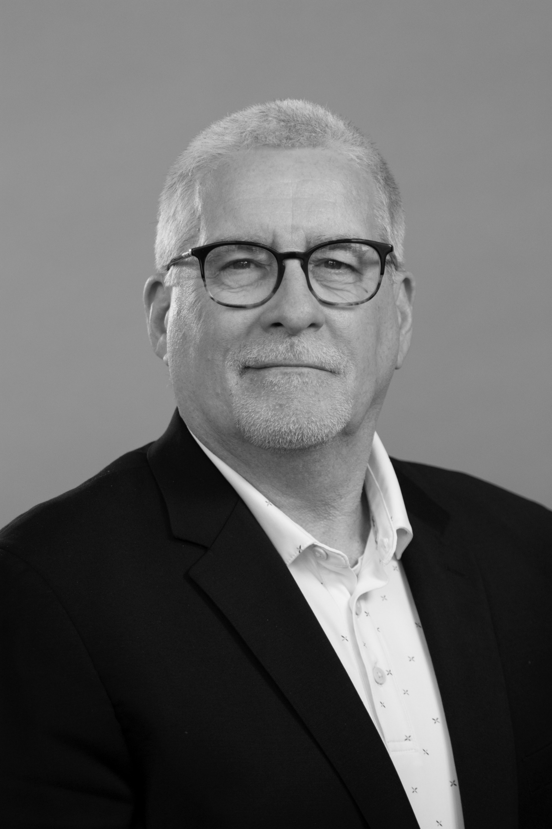
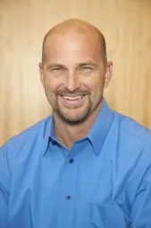
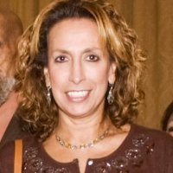
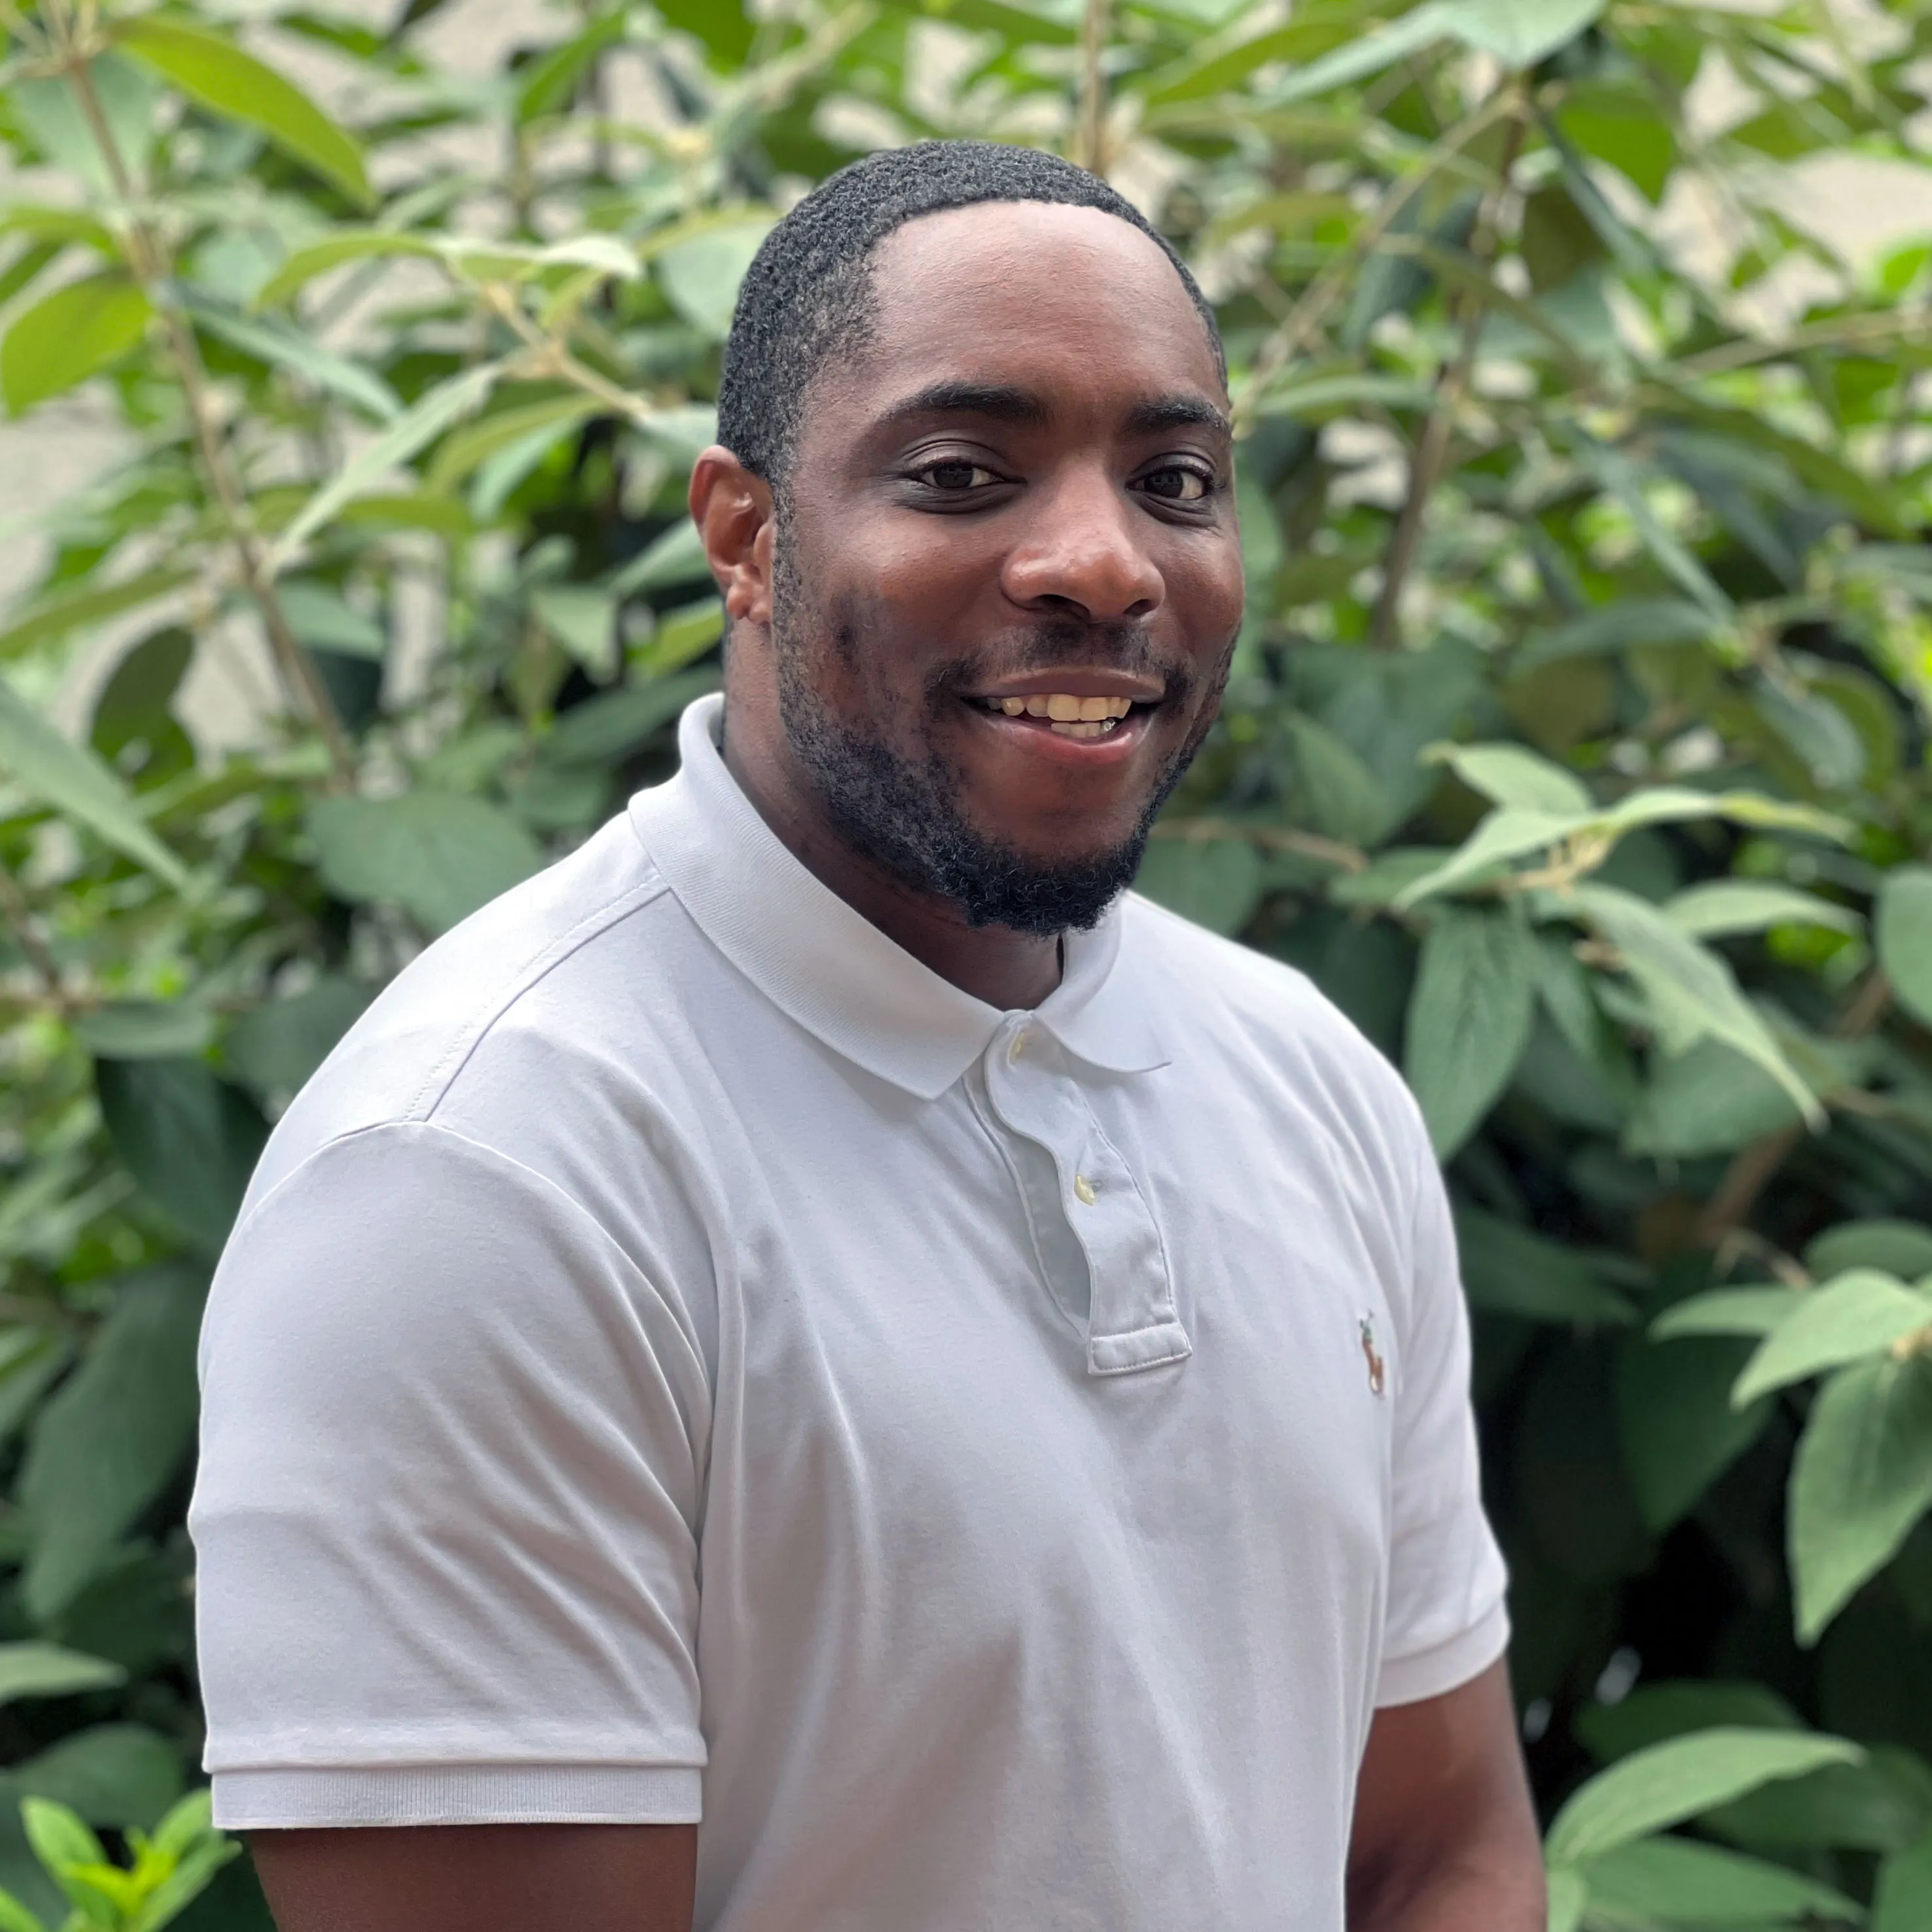
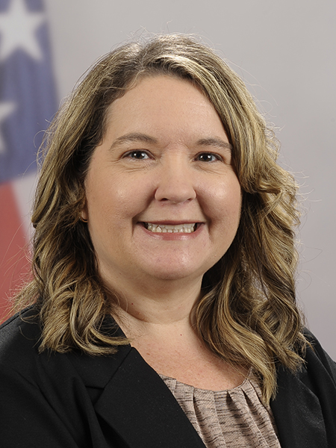
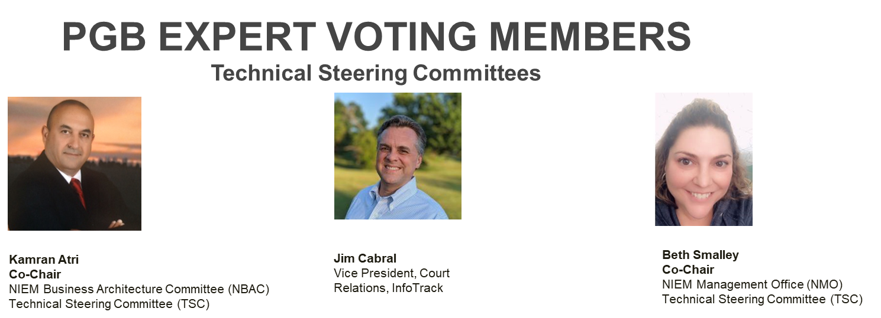

PGB APPOINTED VOTING MEMBERS
Ms. Katherine Escobar
PGB Chair
Deputy Division Chief, Data and Standards Division at Joint Staff J6 and NIEM Managing Director
Ms. Christina Bapst-Stump
Science and Technology Directorate, US Department of Homeland Security
Mr. Gary Egner
Director Business Development, Equivant
Mr. John Wandelt
Principal Research Scientist, Georgia Tech Research Institute
Ms. Maria Cardiellos
Executive Director
Integrated Justice Information Systems Institute
Mr. Payton Lamb
Data Engineer
Commonwealth of Virginia
Office of the secretary of Administration
Office of Data Governance and Analytics
Ms. April Mitchell
FBI It Specialist and Technical Lead of Data Standards in the Criminal Justice Information Services (CJIS) Division
Notes:
Open Project Rules - OASIS Open (oasis-open.org)
5.1 Overall guidance for the Project is provided by its Project Governing Board (or PGB). The PGB is composed of one voting member from each Project Sponsor who elects to appoint a PGB member, and (a) if the PGB has one or more Technical Steering Committees, one voting expert representative from each TSC, elected or appointed by that TSC, or (b) otherwise, the PGB may appoint at least one and no more than two voting expert representatives from its community of contributors. The PGB may create additional non-voting PGB member seats for expert representatives to be elected by the TSC or appointed by the PGB. The PGB membership of all such members of any type is conditioned on satisfaction of the CLA requirement of Section 5.2. Voting status on the PGB may be affected by the provisions of Section 5.7.

Slide 8
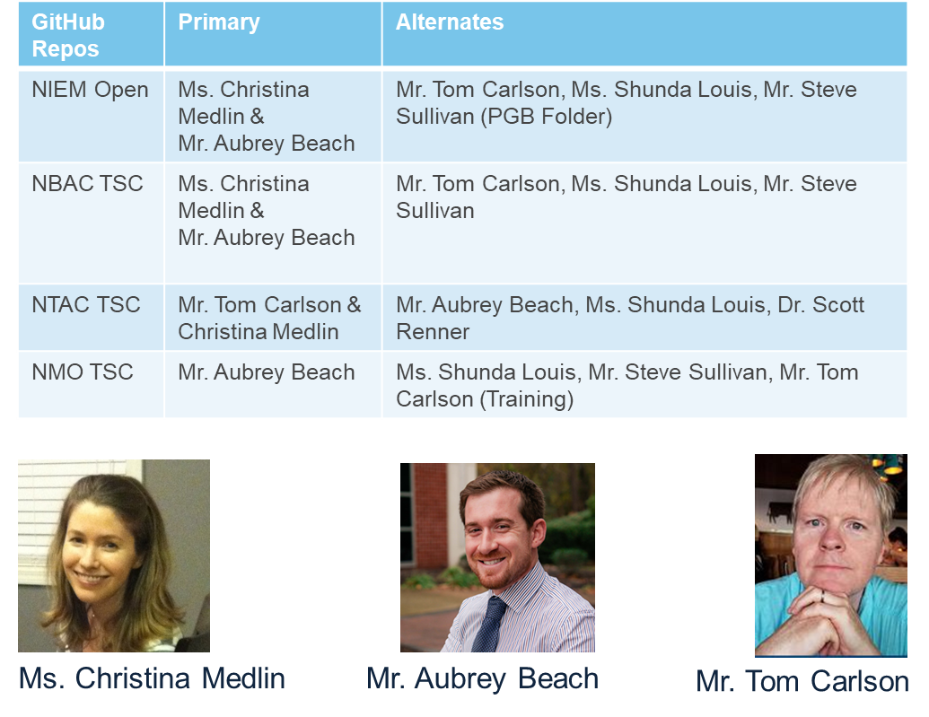
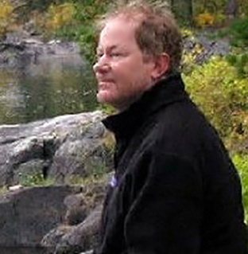
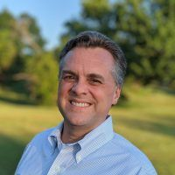
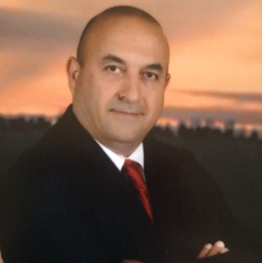
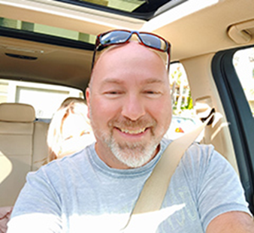

NMO, NBAC, & NTAC TSC Co-Chairs & OASIS Maintainers
TSC | Approved (TSC CHAIRS)
NMO TSC | Ms. Katherine Escobar & Ms. Beth Smalley
NBAC TSC | Mr. Kamran Atri & Mr. Thomas Krul
NTAC TSC | Dr. Scott Renner & Mr. Jim Cabral
NTAC TSC
NBAC TSC
NMO
TSC

Slide 9
Proposed 11 April 2024 PGB Agenda
Call to Order
Admin
TEAMS Link
Meeting Etiquette
Note Takers
Roll Call & Introductions
PGB Voting Members (Sponsors)
PGB Expert Voting Members (TSCs)
PGB Non-Voting Members (TSC Co-Chairs)
TSC Co-Chairs & NIEMOpen Maintainers
Approval of Agenda
Around-the-Horn – PGB Voting Members
Approval of Meeting Minutes from 25 Jan 2024
OASIS Staff / NIEMOpen Administrator Comments
Q1 Financial Snapshot – Cathie Mayo (OASIS)
Sponsor Update – Carol Geyer
CY 2024 Planning
5 Minute Break
Motions
Motion to approve CY 2024 Q3 &4 PGB Revised Meeting Dates – Beth Smalley
NIEMOpen Reveal Event Update – Katherine Escobar
Motion to approve Committing funds to reserve facilities at the National Press Club– Beth Smalley
PS02 Update – Jim Cabral
Motion to approve Updating NIEM Model Version 6.0 to PS02.
Updates
NTAC Update
Common Model Format (CMF)
CMF Tool
NDR
NBAC Update – Kamran Atri
NMO Update
NMO TSC Transition – Katherine Escobar
API 2.0 – Shunda Louis
MEP Tool – Aubrey Beach
Comms & Outreach SC – Paul Wormeli
Next Meeting
Other Business/General Discussion
Questions/Adjourn

Slide 10
Approval of Agenda
Chair: A Draft Agenda for the NIEMOpen 11 Apr 2024 Project Governing Board (PGB) Meeting was provided to PGB Voting Members as a readahead.
Chair: Are there any recommended changes to the agenda as distributed?
Chair: If there are no (further) changes, the agenda stands approved as distributed (corrected).
?
Approve
Approve as Corrected
Notes:
Chair asks PGB to approve 25 January 2024 PGB Meeting AGENDA.

Slide 11


bluf
PGB CALL TO ACTION
There is a cost to produce model releases, maintenance & updates:
Development Support
OASIS Workflow
Project Specification Draft
Project Specification
OASIS Standard
Harmonization
Model Release
3 FTE @ $1M ROM
Sources of Funding
Description | Status
Crowdsourcing funding through sponsorship ($ 100K surplus/YR) | Q1 2024 ~33K
Contributions beyond sponsor dues | Q1 2024 = 0
In-kind labor | Non-contract NMO, NBAC, NTAC & PGB
Special events: 2025 NIEMOpen Reveal surplus $ (~ $ 25 k) | Q1 2024 = 0
Monetizing key activities: training help desk & tech support | Q1 2024 = 0
Notes:
Chair asks PGB to approve 11 April 2024 PGB Meeting AGENDA.

Slide 12

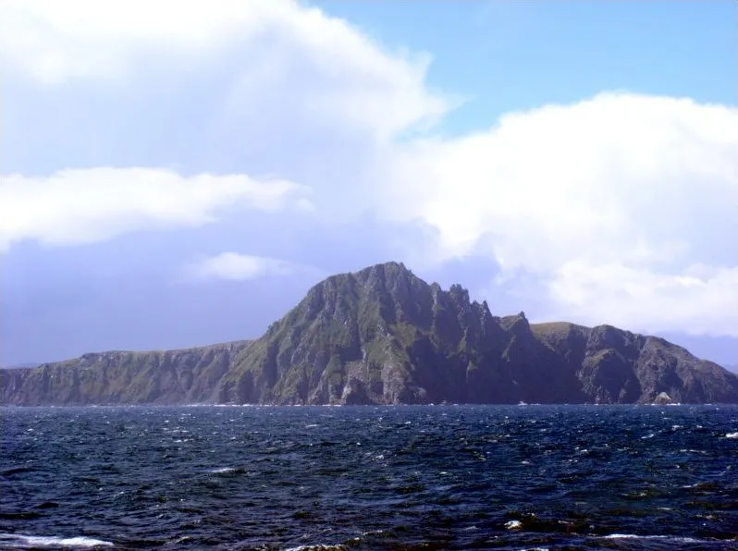
PGB MEMBERS: Around-the-horn
Notes:
The Go Around gives each person a brief turn to speak, without interruption. Everyone else listens. Also known as a Round Robin, Structured Go Around, or as going “Around the Horn”, this foundational meeting tool ensures that everyone can contribute their thoughts and comments.
The pictures on the slide is a metaphor for “Around the Horn”. It depicts the fictional ship, “the Black Pearl” transiting Cape Horn, the horn of Southern Chile. Located off the southern tip of mainland South America, it was named Hoorn for the birthplace of the Dutch navigator Willem Corneliszoon Schouten, who rounded it in 1616.

Slide 13
Approval of 25 Jan 2024 PGB Minutes
Chair: A Draft of the NIEMOpen 26 October 2023 PGB meeting minutes was provided to the PGB Voting Members as a readahead: https://github.com/niemopen/oasis-open-project/blob/main/pgb-meeting-minutes/2024/25-January-2024/(DRAFT)%20NIEMOpen%20PGB%20Meeting%20Minutes%2025%20Jan%202024%20v2%201-30-2024.docx
Please let me know now if you found any errors.
Chair: Are there any corrections to the minutes as distributed?
Chair: If there are no (further) corrections, the minutes stand approved as distributed (corrected).
?
Approve
Approve as Corrected
Notes:
Chair requests that 25 Jan PGB Meeting minutes be approved.

Slide 14
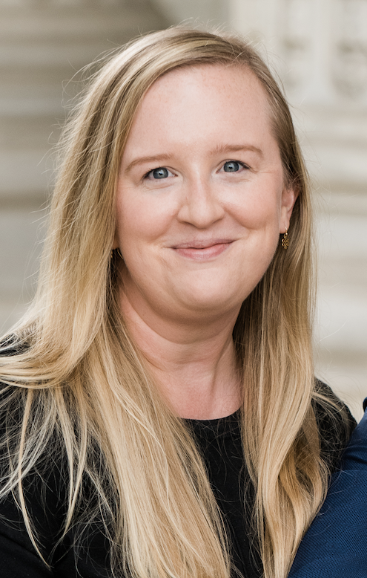
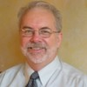
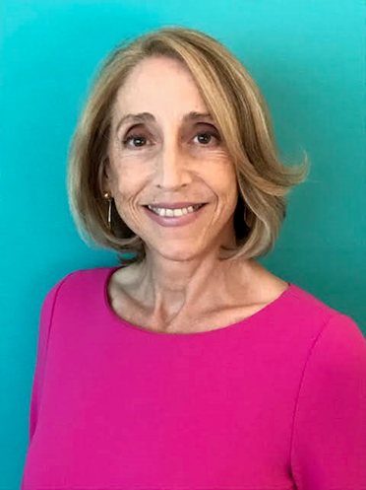
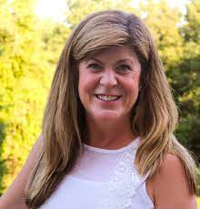
OASIS STAFF/ OP ADMINISTRATORS
Mr. Chet Ensign – Chief Technical Community Steward at OASIS/ OP Administrator
Ms. Carol Geyer – OASIS Open Chief Development Officer
Ms. Kelly Cullinane – OP Administrator
Ms. Cathie Mayo – OASIS Controller
Notes:
Introduce OASIS Staff to new PGB Members

Slide 15
CY 2023 Q4 Financials
Ms. Cathie Mayo – OASIS Controller
Notes:
Chair introduces Cathie Mayo

Slide 16






















NIEMOpen Current SPONSORS “No Change”
Sponsors
JS J6
DHS S&T
CJIS (FBI)
GTRI
NAJIS
IJIS
DOT
ODGA (Virginia)
Equivant
9 Sponsors, 3 Premier
S&T
S&T
Premier
Premier
Premier
In Discussions
Microsoft
DHS OBIM
DND, Canada
DOJ
DHS OBIM
Expressed Interest
MITRE
Veterans Administration
Tyler technologies
Ernst & Young
NIST
DISA
NOAA
Pinary
Department of National Defense
Ms. Carol Geyer
– OASIS Open Chief Development Officer

Slide 17

CY 2024 NIEM Open planning
Complete
NIEM Version 6.0 Project Specification (PS01)
Implement EIN Presswire
J6 Complete/contribute MEP tool and host on AWS
Implement LearnPress LMS
Complete/IOC MEP Builder Tool
Complete NIEM API 2.0
Planned/ In Progress 2024
Submit NIEM 6.0 NDR as PSD/ PS
Submit NIEM Model Version 6.0 PS02
Submit NIEM Model Version 6.0 PS02 as an OS
Solicit 3 statements of use
Transfer Training Equities to NMO TSC Training Repo
Update Training Materials to reflect Model Version 6.0 Updates
Update/integrate LearnPress LMS w/Model Version 6.0
Complete NIEM API 2.0
Develop/Complete NIEM Model Version 6.1
Submit NIEM Model Version 6.1 as Open Project Release
Complete/contribute CMF tool
Complete transfer of github.io files to NIEMOpen
Execute 2025 NIEMOpen Reveal
Complete/IOC MEP Builder Tool
Recurring/On-Going
Identify Potential Sponsors/Conduct Outreach
Populate OASIS Jira & Confluence Site
Conduct Monthly Synch w/ OASIS Staff
Obtain Contributor License Agreements
Bi-Weekly synch with 2025 Symposium Planning Team

Slide 18
PGB Topics for Consideration & Vote
Motions
Approve Revised CY 2024 Q3 & 4 PGB Meeting Dates
Approve resources to secure meeting facilities (Ballroom & 2 breakout rooms) at the National Press Club for the NIEMOpen REVEAL event
Motion to Approve Updating NIEM Model version 6.0 (PS01) to PS02 to redress minor Bug Fixes & administrative corrections
Updates
NTAC TSC
NABC TSC
NMO TSC

Slide 19
Motion to Approve CY 2024 (Q 3, & 4) Revised PGB Meeting dates
Chair: A proposal to approve updating CY 2024 Q 3 & 4 PGB Meeting Dates was submitted as a readahead to PGB Voting Members.
Maker: (NMO-Beth Smalley) I motion that the following PGB Meeting Dates be accepted for the remainder of CY 2024:.
SECOND?
Chair: (Debate) Do any of the members have comments on the proposal?
Chair: Conducts a Simple Majority Vote
Chair: Announces Vote
Resolution
?
Approve
CY 2024 Meeting Dates
Q3 | AUG 1 | 2 – 4 PM | EDT
Q4 | NOV 7 | 2 – 4 PM | EDT
Approve w/Comment
Table/Reject
Notes:
1. The member (Beth Smalley) addresses the chair – “Madam Chairman”
2. The chair recognizes the member – “The chair recognizes Beth Smalley”
3. The member (Maker-Beth Smalley) makes a motion – I motion the PGB approve the following PGB meeting dates for CY 2024:
August 1, 2024, 2-4 PM EDT
November7, 2024, 2-4 PM EDT
4. Another member seconds the motion – SECOND
5. Chair: “It is moved and seconded to adopt the motion.
6. The members debate the motion
7. Chair: Those in favor of adopting the motion to approve say ‘Aye.’ [pause] Those opposed, say ‘No.’”
8. Chair: Announce the result
If no objections
Chair: Without objection, approved

Slide 20
NIEMOpen Reveal Update
Data Standard, Redefining the International Information Landscape
11 April 2024
Ms. Katherine Escobar
NIEMOpen Project Governing Board Chair

Slide 21
Purpose & GOALS
Reveal the “new” NIEMOpen after transitioning to an OASIS Open Project
The event will offer a cost-effective training and recruitment platform for NIEMOpen, establishing an annual training gathering for IT professionals spanning Federal, State, Local, Tribal, International, and Commercial sectors.
Objectives
Facilitate interactions among open-source community members, providing them with the opportunity to meet, share insights, and learn from leaders of NIEMOpen, OASIS, and sponsoring partners regarding NIEMOpen implementation.
Re-establish an annual opportunity for the NIEMOpen community and partners to connect with each other and engage with senior PGB leadership.
Formal Recognition “Awards” NIEMOpen exemplary work.
Increase Community awareness
Potential funding surplus to support NIEMOpen tech development
Sponsorship recruitment
Vendor engagement

Slide 22
Program considerations
Agenda: Spanning three days and encompassing up to three tracks:
Plenary
Technical Primer
Expert Technical
“Hackathon”
Tracks: Tailored for diverse roles in NIEMOpen, aligning with its dedication to supporting member organizations' missions.
Plenary: focusing on issues of interest to the broad information exchange and Standards communities
2 Training Tracks: offering both Primer and Expert NIEM Model and architecture technical sessions, standalone talks, interactive panels, and/or expertly moderated Q&A sessions.
Hackathon: NIEMOpen offsite developer challenge coincident with ongoing Reveal events. Winners selected on last day and announced at plenary.
Keynotes: From various levels of government and industry
Speakers: To feature former trailblazers from founding organizations like DHS, DOJ, and Health & Human Services to newcomers within the community. Speakers to be recruited both by invitation and open call for presentations.

Slide 23
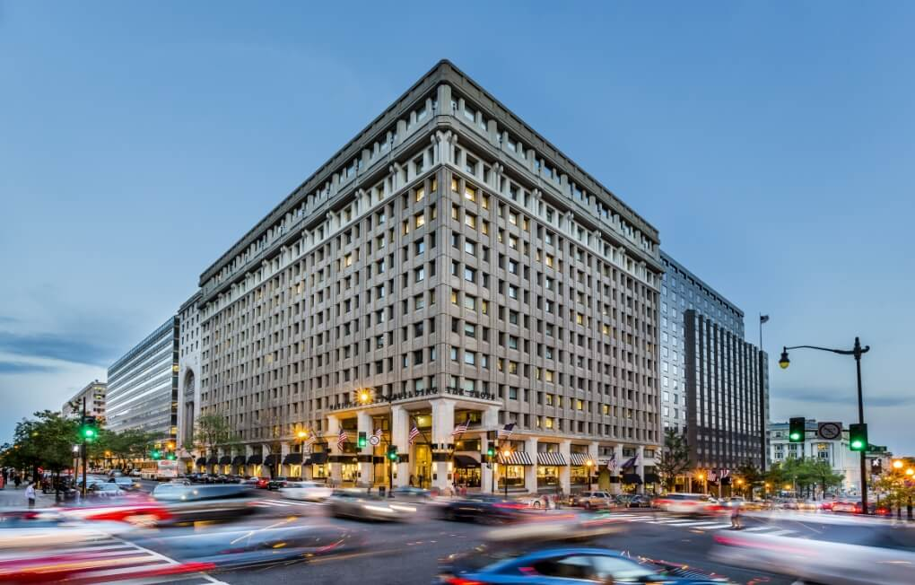
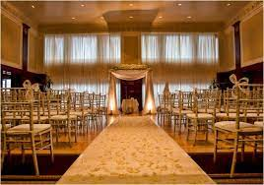
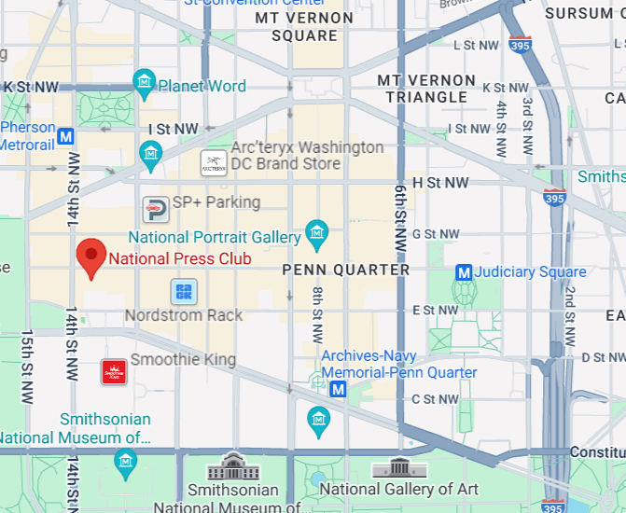

National press club
Homepage | National Press Club
Located in: National Press Building
Address: 529 14th St NW, Washington, DC 20045
Founded: March 29, 1908
Phone: (202) 662-7500

Slide 24
FINANCIAL Background
Event Expenses: Hosting a 300-person event will incur costs ranging from $150,000 to $225,000
Event Revenue: Funding to cover expenses will come from a mixture of sponsorship and registration fees.
Deposit: Advance payment funding up to $40,000 will be involved (non-refundable/transferrable).
Event Profit: Profit from the event will go back to the NIEMOpen project.
NIEMOpen Training Summit Draft Budget
 |  |  | Preliminary Estimate
# | Registration Revenue
30 | Attendance Fee (early bird before 15 November) | $ 695.00 | $ 20,850.00
20 | Attendance Fee (late after 15 November) | $ 795.00 | $ 15,900.00
100 | Government, non-profit, academics (early bird before 15 November) | $ 395.00 | $ 39,500.00
80 | Government, non-profit, academics (late after 15 November) | $ 495.00 | $ 39,600.00
70 | Complimentary (speakers) | $ -
0 | Reception Ticket | $ 50.00 | $ -
300 | Total Registration Income |  | $ 115,850.00
# | Sponsorship Revenue
1 | Diamond Sponsorship (reception-table-speaking op) | 25,000 | $ 25,000.00
2 | Platinum Sponsorship (speaking op-table) | 15,000 | $ 30,000.00
4 | Gold Sponsorship (table) | 10,000 | $ 40,000.00
2 | Silver Sponsorship (breaks/lunches) | 7,500 | $ 15,000.00
3 | Logo Only Sponsorship | 1,500 | $ 4,500.00
7 | Total Sponsorship Income |  | $ 89,500.00
 | Total Potential Venue Expenses |  | $ 165,152.00
 | Total Potential Revenue |  | $ 205,350.00

Slide 25
Motion to commit resources to secure meeting facilities (Ballroom & 2 breakout rooms) at the national press club for the NIEMOpen REVEAL event
Chair: A proposal to commit ~ $ 31K (after rebate) to secure meeting facilities at the National Press Club.
Maker: (NMO TSC: Beth Smally) I motion that the PGB approve:
Committing approximately 31K to secure meeting facilities at the National Press Club contingent on the availability of funds.
Note, the total cost after rebate is expected to be $31K.
This expenditure is expected to be recovered via sponsors and registration fees.
SECOND?
Chair: (Debate) Do any of the members have comments on the proposal?
Chair: Conducts a Simple Majority Vote
Chair: Announces Vote
Resolution
Approve
Approve w/Comment
Table/Reject
Notes:
1. The member (Beth Smalley) addresses the chair – “Madam Chairman”
2. The chair recognizes the member – “The chair recognizes Beth Smalley”
3. The member (Maker-Beth Smally) makes a motion – I motion that the PGB approve:
To continue event planning & preparations for a 2025 NIEMOpen Symposium
Commit approximately K to secure meeting facilities at the National Press Club contingent on the availability of funds.
4. Another member seconds the motion – SECOND
5. Chair: “It is moved and seconded to adopt the motion.
6. The members debate the motion
7. Chair: Those in favor of adopting the motion to approve say ‘Aye.’ [pause] Those opposed, say ‘No.’”
8. Chair: Announce the result
If no objections
Chair: Without objection, approved

Slide 26
NIEM Model 6.0 PS02
One minor change to a technical architecture namespace
Complex types in structures namespace must have appliesToParent attribute
No change to model content
Ready for approval vote today

Slide 27
Motion to Approve Updating NIEM Model version 6.0 (PS01) to PS02 to redress MINOR Bug Fixes & administrative corrections
Chair: A proposal to approve updating NIEM Model Version 6.0 (PS01) to PS02 will be proposed by the NTAC TSC. Included in the motion is direction to publish PS02 to the OASIS Library once approved by the PGB.
Maker: (NTAC Co-Chair Jim Cabral) I Motion that the PGB approve updating the NIEM Model Version 6.0 (PS01) as contained in:
Markdown (Authoritative): https://docs.oasis-open.org/niemopen/niem-model/v6.0/ps01/niem-model-v6.0-ps01.md HTML: https://docs.oasis-open.org/niemopen/niem-model/v6.0/ps01/niem-model-v6.0-ps01.html PDF: https://docs.oasis-open.org/niemopen/niem-model/v6.0/ps01/niem-model-v6.0-ps01.pdf
Complete Package ZIP file at: https://docs.oasis-open.org/niemopen/niem-model/v6.0/ps01/niem-model-v6.0-ps01.zip
as PS02, redressing minor bug fixes and
administrative corrections as needed.
Furthermore, direct the Chair to work with OASIS staff to publish the PS02 to the OASIS Library once approved by the PGB.
SECOND?
Chair: (Debate) Do any of the members have comments on the proposal?
Chair: Conducts a Simple Majority Vote
Chair: Announces Vote
Resolution
Approve
Approve w/Comment
Table/Reject
Notes:
1. The member (Jim Cabral) addresses the chair – “Madam Chairman”
2. The chair recognizes the member – “The chair recognizes Mr. Cabral”
3. The member (Maker-Jim) makes a motion:
I Motion that the PGB approve updating the NIEM Model Version 6.0 (PS01) contained in:
Markdown (Authoritative): https://docs.oasis-open.org/niemopen/niem-model/v6.0/ps01/niem-model-v6.0-ps01.md HTML: https://docs.oasis-open.org/niemopen/niem-model/v6.0/ps01/niem-model-v6.0-ps01.html PDF: https://docs.oasis-open.org/niemopen/niem-model/v6.0/ps01/niem-model-v6.0-ps01.pdf
Complete Package ZIP file at: https://docs.oasis-open.org/niemopen/niem-model/v6.0/ps01/niem-model-v6.0-ps01.zip
as PS02, minor bug fixes and administrative corrections as needed.
Ffurthermore, direct the Chair to work with OASIS staff to publish the PS02 to the OASIS Library once approved by the PGB.
4. Another member seconds the motion – SECOND
5. Chair: “It is moved and seconded to adopt the motion.
6. The members debate the motion
7. Chair: Those in favor of adopting the motion to approve say ‘Aye.’ [pause] Those opposed, say ‘No.’”
8. Chair: Announce the result
If no objections
Chair: Without objection, approved

Slide 28

BREAK

Slide 29
NTAC TSC Update
PS02 ( Discussed as predicate to motion to approve)
Common Model Format (CMF)
CMF Tool – Dr. Scott Renner
NDR – Dr. Scott Renner

Slide 30
Common Model Format (CMF)
The alpha-3 version of CMF 1.0 is posted
Integrated with CMFTool
Basically stable, no major revisions expected
Ready to enter PSD01 process

Slide 31
CMFTool
A command-line developer tool for working with NIEM XSD and CMF
Also provides functionality to API 2.0
Provides round-trip translation between NIEM XSD and CMF
Also generates simplified message schema XSD
Addresses several developer complaints
The alpha-2 version of CMFTool 1.0 is posted
Not a specification, no PSD process required
Bug reports and change requests are anticipated

Slide 32
NDR 6.0 Revision
A major rewrite of NDR 5.0
A new abstract UML metamodel defining the information content of a NIEM model
Two concrete model formats: XSD and CMF
Two supported message formats: XML and JSON
Simplified conformance rules for message schemas
Changes to augmentation and metadata
More explanation, (slightly) less technical detail
A working outline and initial version is posted
Progress is progressing

Slide 33
NBAC TSC Update
Update NIEM MODEL Version 6.0 PSO1 TO PS02
Obtain 3 Statements-of-Use for NIEM Model 6.0
Advance NIEM Model Version 6.0 PS02 to OS
Support NIEMOpen 2025 Reveal

Slide 34
Nmo TSC Update
NIEMOpen Reveal (Discussed as predicate to motion to reserve NPC facilities)
API 2.0 Progress – Ms. Shunda Louis
MEP Tool – Aubrey Beach
NMO TSC Transition Planning Katherine Escobar
Communications & Outreach Sub-Committee

Slide 35
API 2.0 Update
Completed actions:
Alpha | Focus | Description | Comments
1 | Transforms | Convert [CMF or XSD] to [CMF, XSD, OWL, or JSON Schema] | Other output transformation modules should be added later (e.g., spreadsheet, CSVs, lite UML, etc.)
2 | Get model details | Get information about stewards, models, versions, namespaces, properties, types, and facets. Load NIEM 1.0 – 5.2 data. | Multi-model support for NIEM + IEPDs.
3 | Search models | Search properties and types | Code set searching should be added later.
4 | Migrate models | Migrate a supported model from one version to any later version | Runs multiple iterations in one call. Only works for models in the database with migration rules.
5 | Validate models | XML validation for XML, XSD, IEPD catalogs, XML catalogs, CMF files. NDR validation for XSD. | JSON validation and QA rules for properties and types should be added later. Reports in JSON and CSV.
References:
Title | Link | Comments
NIEM Toolbox | https://niemopen.github.io/niem-toolbox/ | Will be available at the end of the current alpha.
NIEMOpen Tool Issue Tracker | https://github.com/orgs/niemopen/projects/4/views/2 | Kanban board for NIEM API and NIEM Toolbox. Click tabs for other groupings and views of the data.
NIEM API 2.0 code | https://github.com/niemopen/niem-api | Code to be posted at the end of the current alpha.
NIEM Toolbox code | https://github.com/niemopen/niem-toolbox | Code to be posted at the end of the current alpha.
NIEM data for the new backend PostgreSQL database | https://github.com/niemopen/niem-api-db | SQL files with NIEM 1.0 – 5.2 data to be posted at the end of the current alpha.

Slide 36
MEP Tool Update
Placeholder – Aubrey Beach

Slide 37
COMMUNICATIONS & OUTREACH SUB-COMMITTEE
Assisting NIEMOpen Management Office on planning for NIEMOpen Reveal
Exploring long term options for NIEMOpen management functions
Developing stewardship resources for inactive domains
Planning with DAMA to expand use cases for NIEMOpen
Presentations on NIEMOpen to industry, Practitioners
Exploring new domains
Soliciting deeper industry participation
Response to inquiries from presentations

Slide 38
NMO Transition
Ms. Katherine Escobar
NIEMOpen Project Governance Board Chair

Slide 39
PGB meeting Schedule
NEXT PGB Meeting
Thursday, 1 August 2024
Virtual Meeting 2 – 4 PM EDT
Virtual: MS TEAMS
Subsequent CY 2024 Meetings
Thursday, 7 November 2024, 2-4 PM EDT
Pending Approval

Slide 40
Other business/Discussion
?

Slide 41


Adjourn
Chair: Do any of the PGB members or our attending guests have any questions?
Chair: Meeting Adjourned

Slide 42
Backups

Slide 43
Slides Pending
# 10 Agenda Update – Steve Sullivan
# 15 Q1 2024 Financials – Cathie Mayo
# 27 PS02 link and ZIP file (add to slide when available)
# 36 MEP - Aubrey
Slides requested by this Thursday, 4 April to make it in the readahead, otherwise
NLT 10 April for 11 April PGB.
Notes:
Chair: This meeting is being recorded for the record and a link will be provided in the minutes.

Slide 44
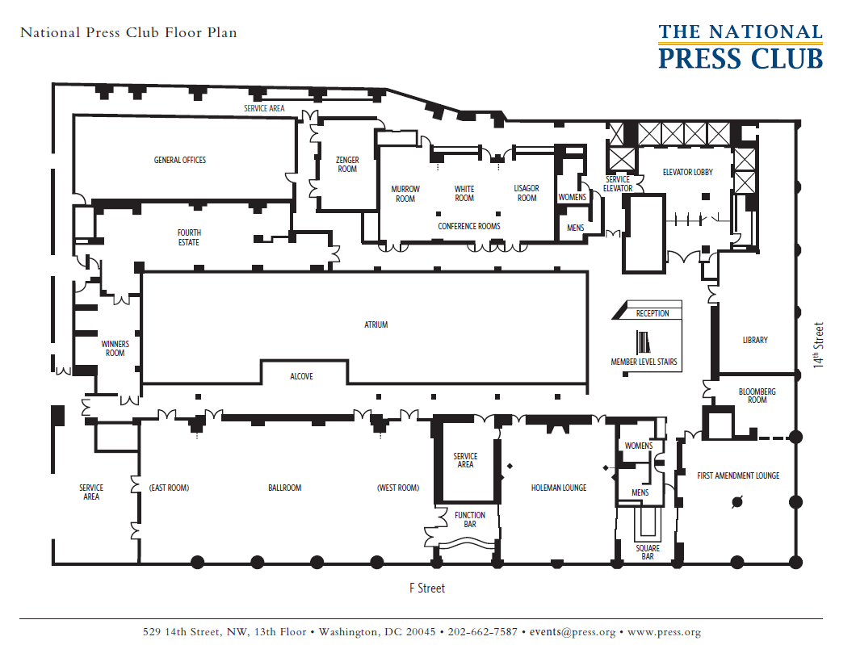

Facilities map
Breakout
Registration
Sponsor/vendor displays
Breakout

Slide 45
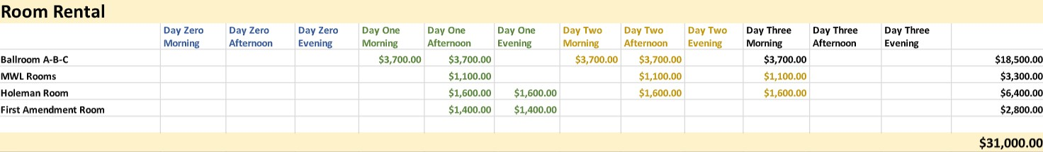
Cost breakout – facilities npc

Slide 46
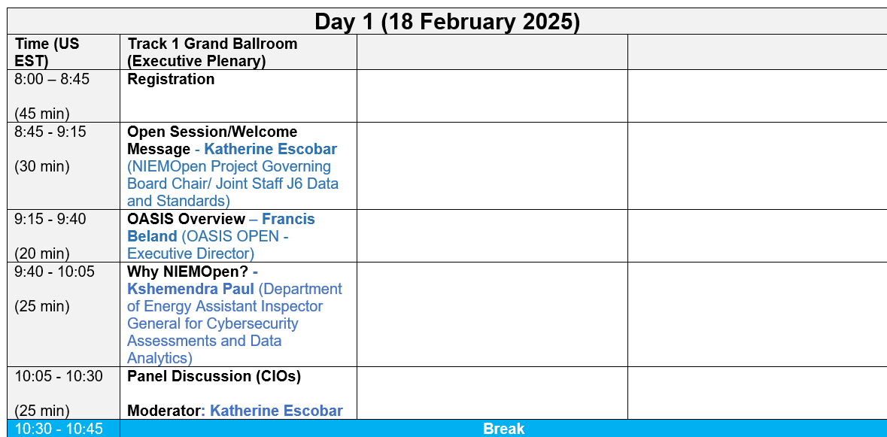
Reveal agenda (day 1, 18 feb 2025)
NIEMOpen Reveal: Data Standard, Redefining the International Information Landscape
Holeman Lounge - Track 2 -- set for either 80 classroom or 100 theatre (or mixture) Conference Rooms (Murrow-White-Lisagor) - Track 3 -- set either 76 classroom or 110 theatre (or mixture)
First Amendment Lounge - Backup for tabletops, Reception space

Slide 47
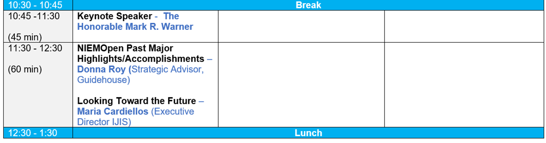
Reveal agenda (day 1, 18 feb 2025)

Slide 48
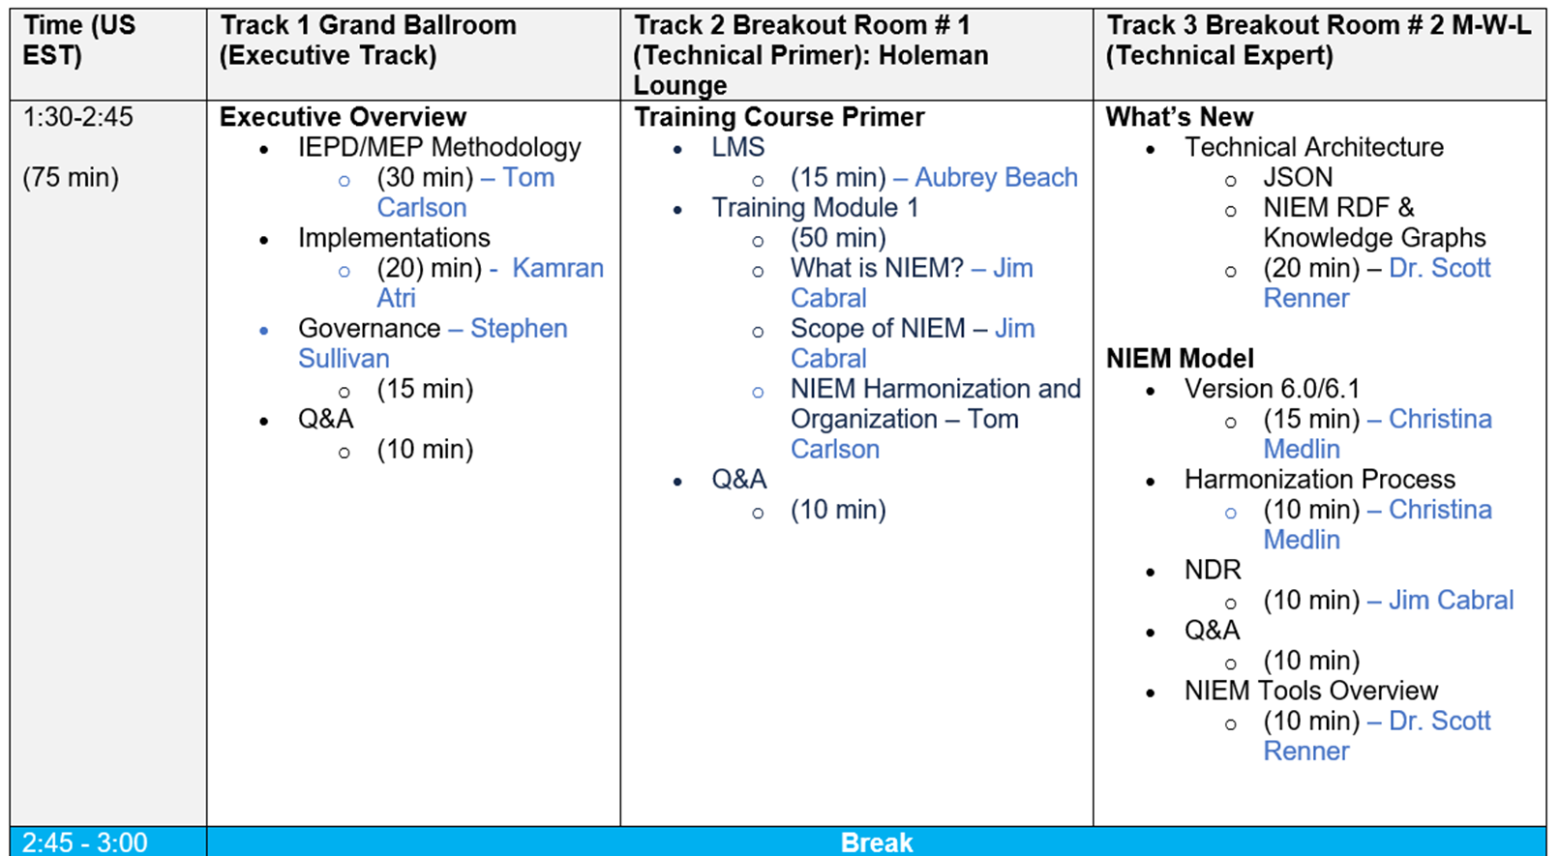
Reveal agenda (day 1, 18 feb 2025)

Slide 49
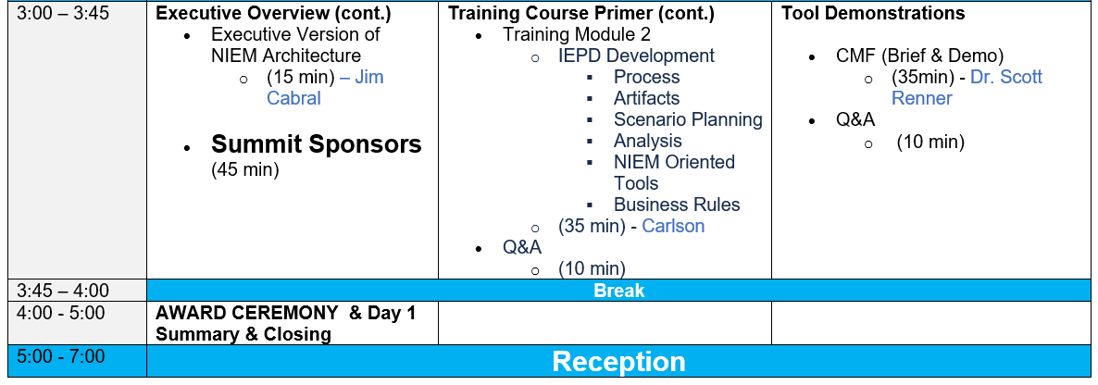
Reveal agenda (day 1, 18 feb 2025)

Slide 50
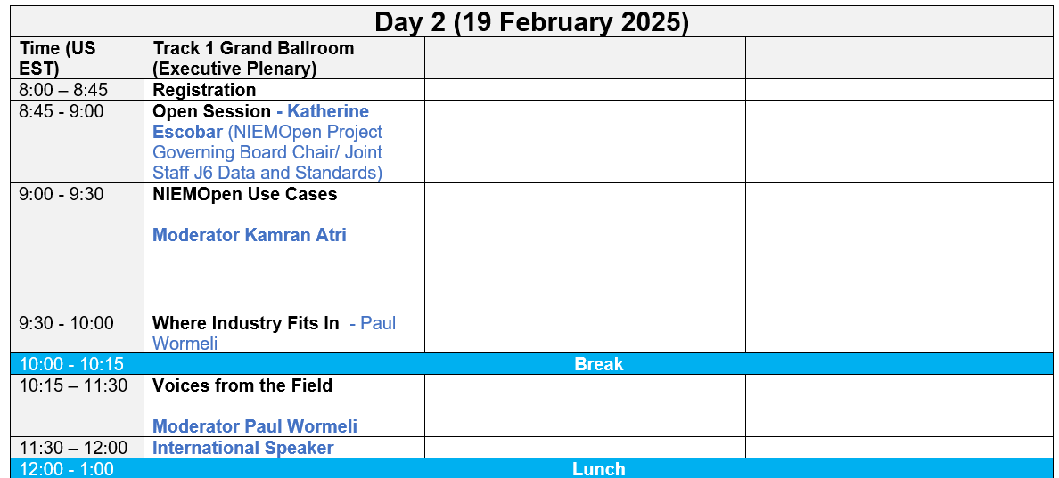
Reveal agenda (day 2, 19 feb 2025)

Slide 51
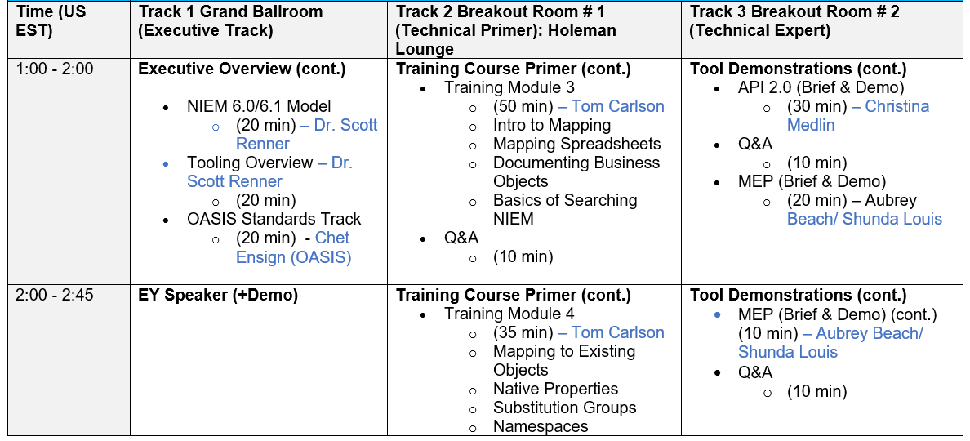
Reveal agenda (day 2, 19 feb 2025)

Slide 52
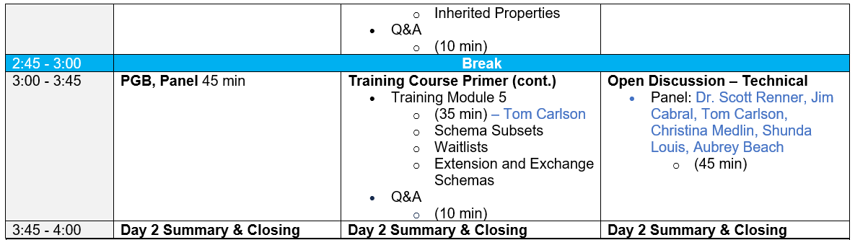
Reveal agenda (day 2, 19 feb 2025)

Slide 53
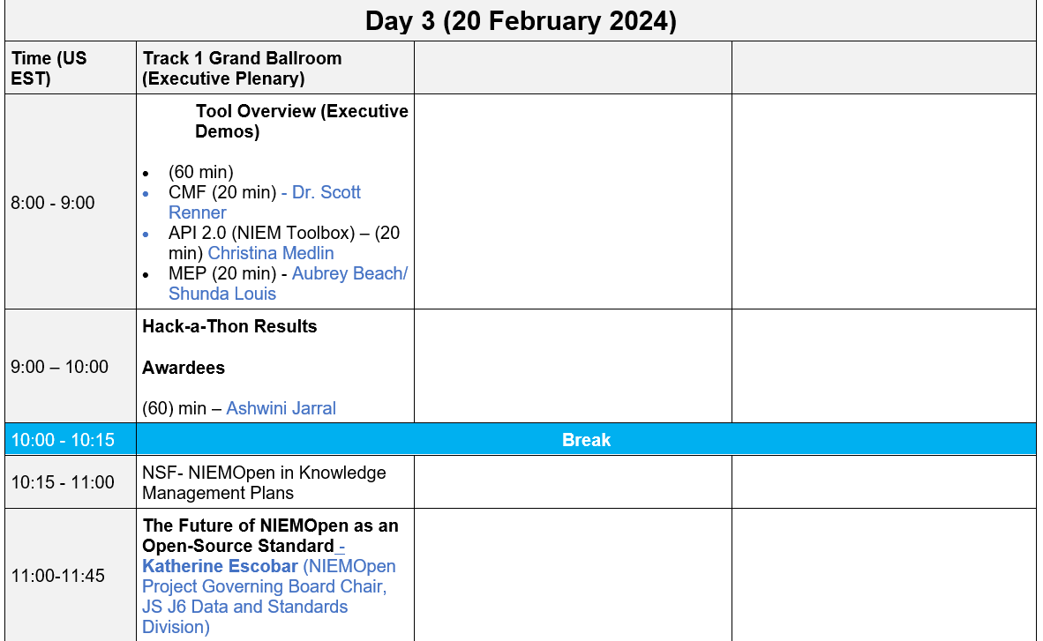
Reveal agenda (day 3, 20 feb 2025)

Slide 54
Motion to Approve Updating NIEM Model version 6.0 (PS01) to PS02 to redress Bug Fixes
Chair: A proposal to approve updating NIEM Model Version 6.0 (PS01) to PS02 will be proposed by the NTAC TSC. Included in the motion is direction to publish PS02 to the OASIS Library once approved by the PGB.
Maker: (NTAC Co-Chair Jim Cabral) I Motion that the PGB approve updating the NIEM Model Version 6.0 (PS01) as contained in:
Markdown (Authoritative): https://docs.oasis-open.org/niemopen/niem-model/v6.0/ps01/niem-model-v6.0-ps01.md HTML: https://docs.oasis-open.org/niemopen/niem-model/v6.0/ps01/niem-model-v6.0-ps01.html PDF: https://docs.oasis-open.org/niemopen/niem-model/v6.0/ps01/niem-model-v6.0-ps01.pdf
Complete Package ZIP file at: https://docs.oasis-open.org/niemopen/niem-model/v6.0/ps01/niem-model-v6.0-ps01.zip
as PS02, redressing minor bug fixes and
administrative corrections as needed.
Furthermore, direct the Chair to work with OASIS staff to publish the PS02 to the OASIS Library once approved by the PGB.
SECOND?
Chair: (Debate) Do any of the members have comments on the proposal?
Chair: Conducts a Simple Majority Vote
Chair: Announces Vote
Resolution
Approve
Approve w/Comment
Table/Reject
Notes:
1. The member (Jim Cabral) addresses the chair – “Madam Chairman”
2. The chair recognizes the member – “The chair recognizes Mr. Cabral”
3. The member (Maker-Jim) makes a motion:
I Motion that the PGB approve updating the NIEM Model Version 6.0 (PS01) contained in:
Markdown (Authoritative): https://docs.oasis-open.org/niemopen/niem-model/v6.0/ps01/niem-model-v6.0-ps01.md HTML: https://docs.oasis-open.org/niemopen/niem-model/v6.0/ps01/niem-model-v6.0-ps01.html PDF: https://docs.oasis-open.org/niemopen/niem-model/v6.0/ps01/niem-model-v6.0-ps01.pdf
Complete Package ZIP file at: https://docs.oasis-open.org/niemopen/niem-model/v6.0/ps01/niem-model-v6.0-ps01.zip
as PS02, minor bug fixes and administrative corrections as needed.
Ffurthermore, direct the Chair to work with OASIS staff to publish the PS02 to the OASIS Library once approved by the PGB.
4. Another member seconds the motion – SECOND
5. Chair: “It is moved and seconded to adopt the motion.
6. The members debate the motion
7. Chair: Those in favor of adopting the motion to approve say ‘Aye.’ [pause] Those opposed, say ‘No.’”
8. Chair: Announce the result
If no objections
Chair: Without objection, approved

Slide 55
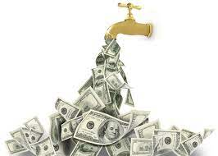
bluf
PGB CALL TO ACTION
There is a cost to produce model releases, maintenance & updates
Development Support
OASIS Workflow
Project Specification Draft
Project Specification
OASIS Standard
Harmonization
Model Release
Sources of revenue include:
Crowdsourcing funding through sponsorship $
Contributions to General Fund and/or supplemental contributions beyond sponsor dues
In kind labor: NMO, NBAC, & NTAC
Special Events: NIEMOpen Reveal surplus $
Monetizing key activities: training, help desk, tech support
3 FTE @ $1M ROM
It will take ~12 new premiere sponsors to annually generate $1M after dues to the General Fund.
Notes:
Chair asks PGB to approve 25 January 2024 PGB Meeting AGENDA.

Slide 56
NIEM API and Toolbox Update
Alpha | Focus | Description | Comments
1 | Transforms | Convert [CMF or XSD] to [CMF, XSD, OWL, or JSON Schema] | Other output transformation modules should be added later (e.g., spreadsheet, CSVs, lite UML, etc.)
2 | Get model details | Get information about stewards, models, versions, namespaces, properties, types, and facets. Load NIEM 1.0 – 5.2 data. | Multi-model support for NIEM + IEPDs.
3 | Search models | Search properties and types | Code set searching should be added later.
4 | Migrate models | Migrate a supported model from one version to any later version | Runs multiple iterations in one call. Only works for models in the database with migration rules.
5 | Validate models | XML validation for XML, XSD, IEPD catalogs, XML catalogs, CMF files. NDR validation for XSD. | JSON validation and QA rules for properties and types should be added later. Reports in JSON and CSV.
6 | Infrastructure and updates | Upgrade CMF tool. Fix bugs. Update testing suites and infrastructure. Add UI for migration and validation. | Also adds better handling for structural updates to production db. Publish code and SQL.
7 | Browse UI | Browse details about NIEM and other models. Load NIEM 6.0 data, plus additional fields. | Add support for type unions, local terminology, legacy fields, and starred components.
8 | Search UI | Search properties, types, and codes
9 | Subsets | Build subsets in UI. Add SSGT wantlist to CMF transform. | New transform supports migrating users away from SSGT without losing their previous work.
10 | Model updates | Low-level functions to update the model. Add support for user permissions. | Allows other users to create models and make incremental changes.
11 | Model mgt artifacts | Load change request spreadsheets and update model. Add CMF to spreadsheet, CSV, and stats transforms. | NIEM 6.1 and future version support. Allows bulk changes via CR spreadsheet.
Feb 12, 2024
Done
In progress
To Do

Slide 57
Support for MEP Builder and to replace legacy tools
Alpha | Focus | MEP Builder | SSGT | Migration Tool | ConTesA | Movement | Model mgt
1 | Transforms | * XSD transform bug | NIEM model to XSD
2 | Get model details (API)
3 | Search models (API)
4 | Migrate models (API)
5 | Validate models (API)
6 | Infrastructure and updates | * Fix XSD transform bug |  | Add UI to Toolbox | Add UI to Toolbox
7 | Browse UI
8 | Search UI
9 | Subsets
10 | Model updates |  |  |  |  |  | Update NIEM model data; add migration rules.
11 | Model mgt artifacts |  |  |  |  |  | Load change requests. Generate version artifacts.
Done
In progress
To Do

Slide 58
Resources
Title | Link | Comments
NIEM Toolbox | https://niemopen.github.io/niem-toolbox/ | Will be available at the end of the current alpha.
NIEMOpen Tool Issue Tracker | https://github.com/orgs/niemopen/projects/4/views/2 | Kanban board for NIEM API and NIEM Toolbox. Click tabs for other groupings and views of the data.
NIEM API 2.0 code | https://github.com/niemopen/niem-api | Code to be posted at the end of the current alpha.
NIEM Toolbox code | https://github.com/niemopen/niem-toolbox | Code to be posted at the end of the current alpha.
NIEM data for the new backend PostgreSQL database | https://github.com/niemopen/niem-api-db | SQL files with NIEM 1.0 – 5.2 data to be posted at the end of the current alpha.

